Slide 1
India Hackathon
4 Aug 2023

Slide 2
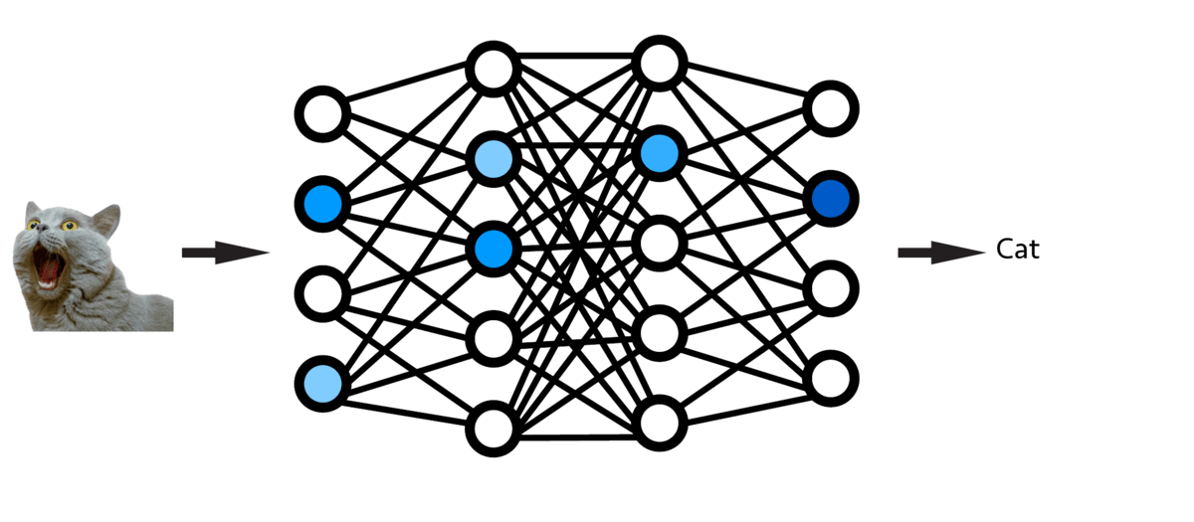
Our Unique Technology
Mimic the human brain - sparse network training
Model converges to same or better accuracy
Less than 1% operations are enough

Slide 3
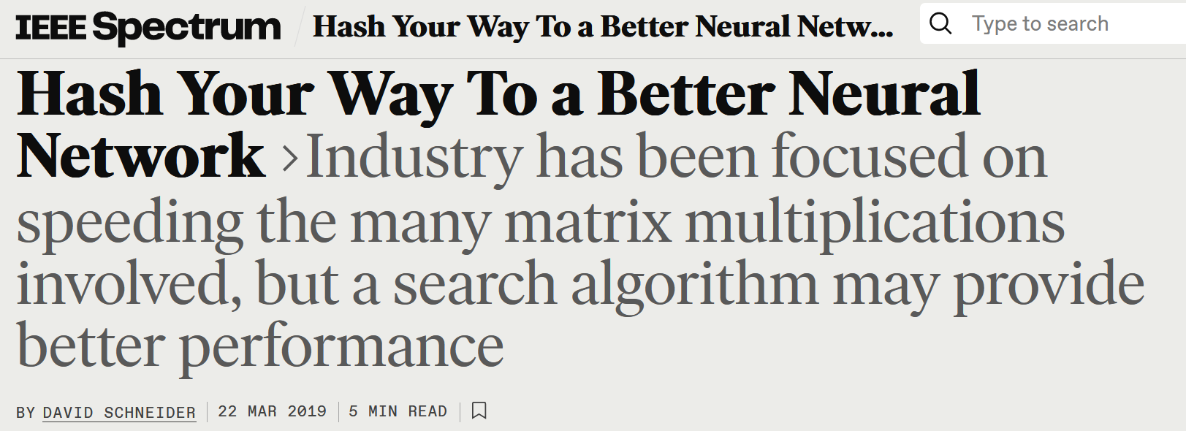
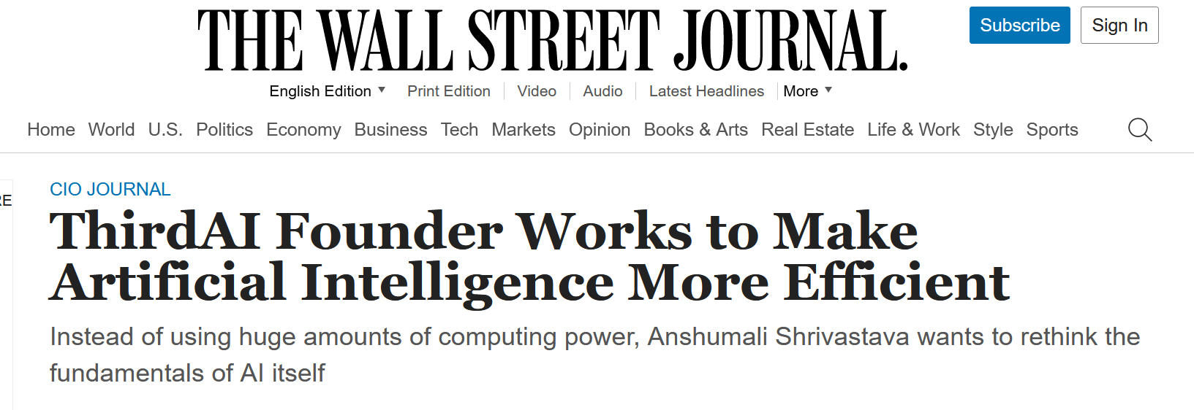
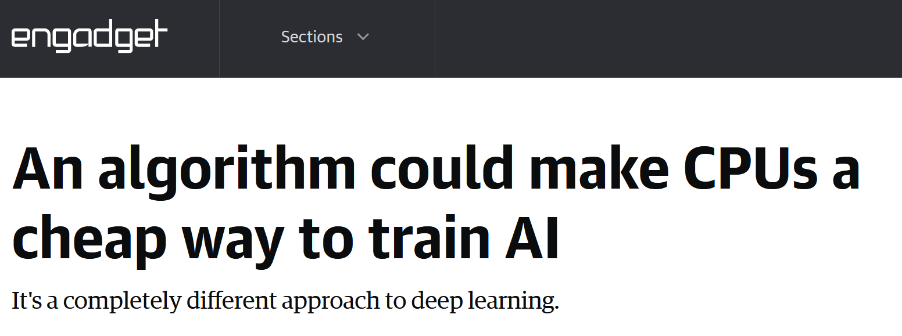
Scientifically Proven Insights (Dozens of Peer-Reviewed Papers)

Slide 4
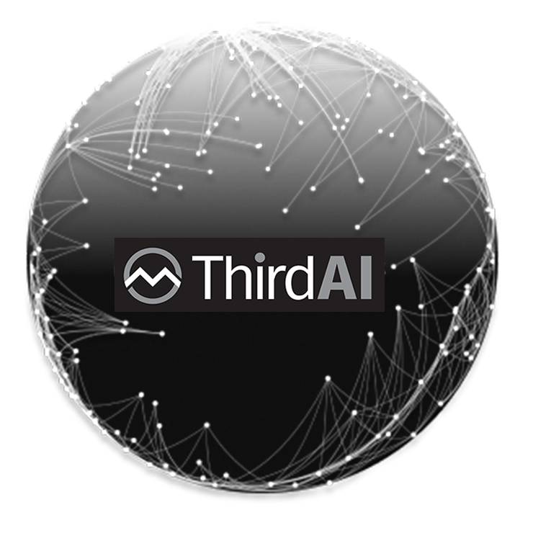




Entire AI/LLM Ecosystem on Commodity CPU for Everyone
Query
Response
Multilingual Knowledge base
Entire LLM Ecosystem on
Simple CPUs
Teach
End User
Train (Unsupervised)
Fine-tune (Supervised)
Teach in Real Time (RLHF)
Simple UI Client
ABSOLUTELY NO CODE
Domain Experts
Beginners

Slide 5
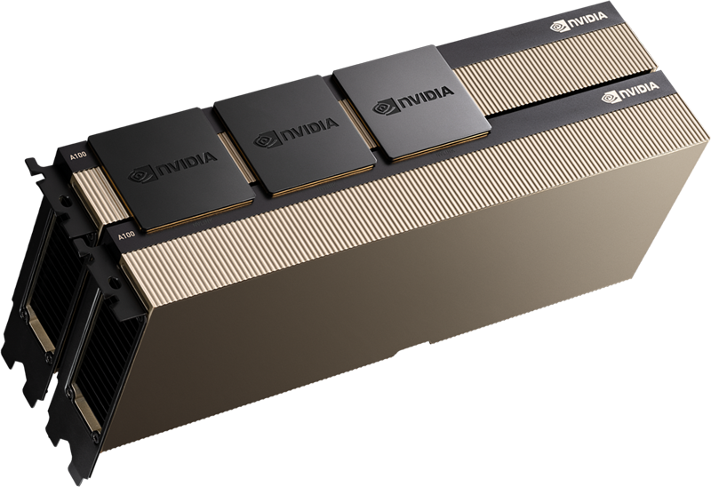

Grounded AI-Agents: Current Ecosystem
Text Embeddings
GPU Heavy
QUESTION
Does my organization provides any retirement benefit?
VECTOR DB
<KEY, VALUE>
0.19, 0.17, …, 1.2
Customer Data Needs to Flow Here
GPU Heavy
Customers Challenges
Privacy
Too much data movement.
Multiple services are required
GPU are scarce.
Poor response time.
Embeddings are at least 3x heavier than actual data
You organization provides 401k retirement benefits for all the employees matching up to 4% contribution.
Response Generation
Vector DB Ecosystem
Customer Data Needs
to Flow Here
Yes, your organization offers 401k benefits and match up to 4% of your contribution

Slide 6
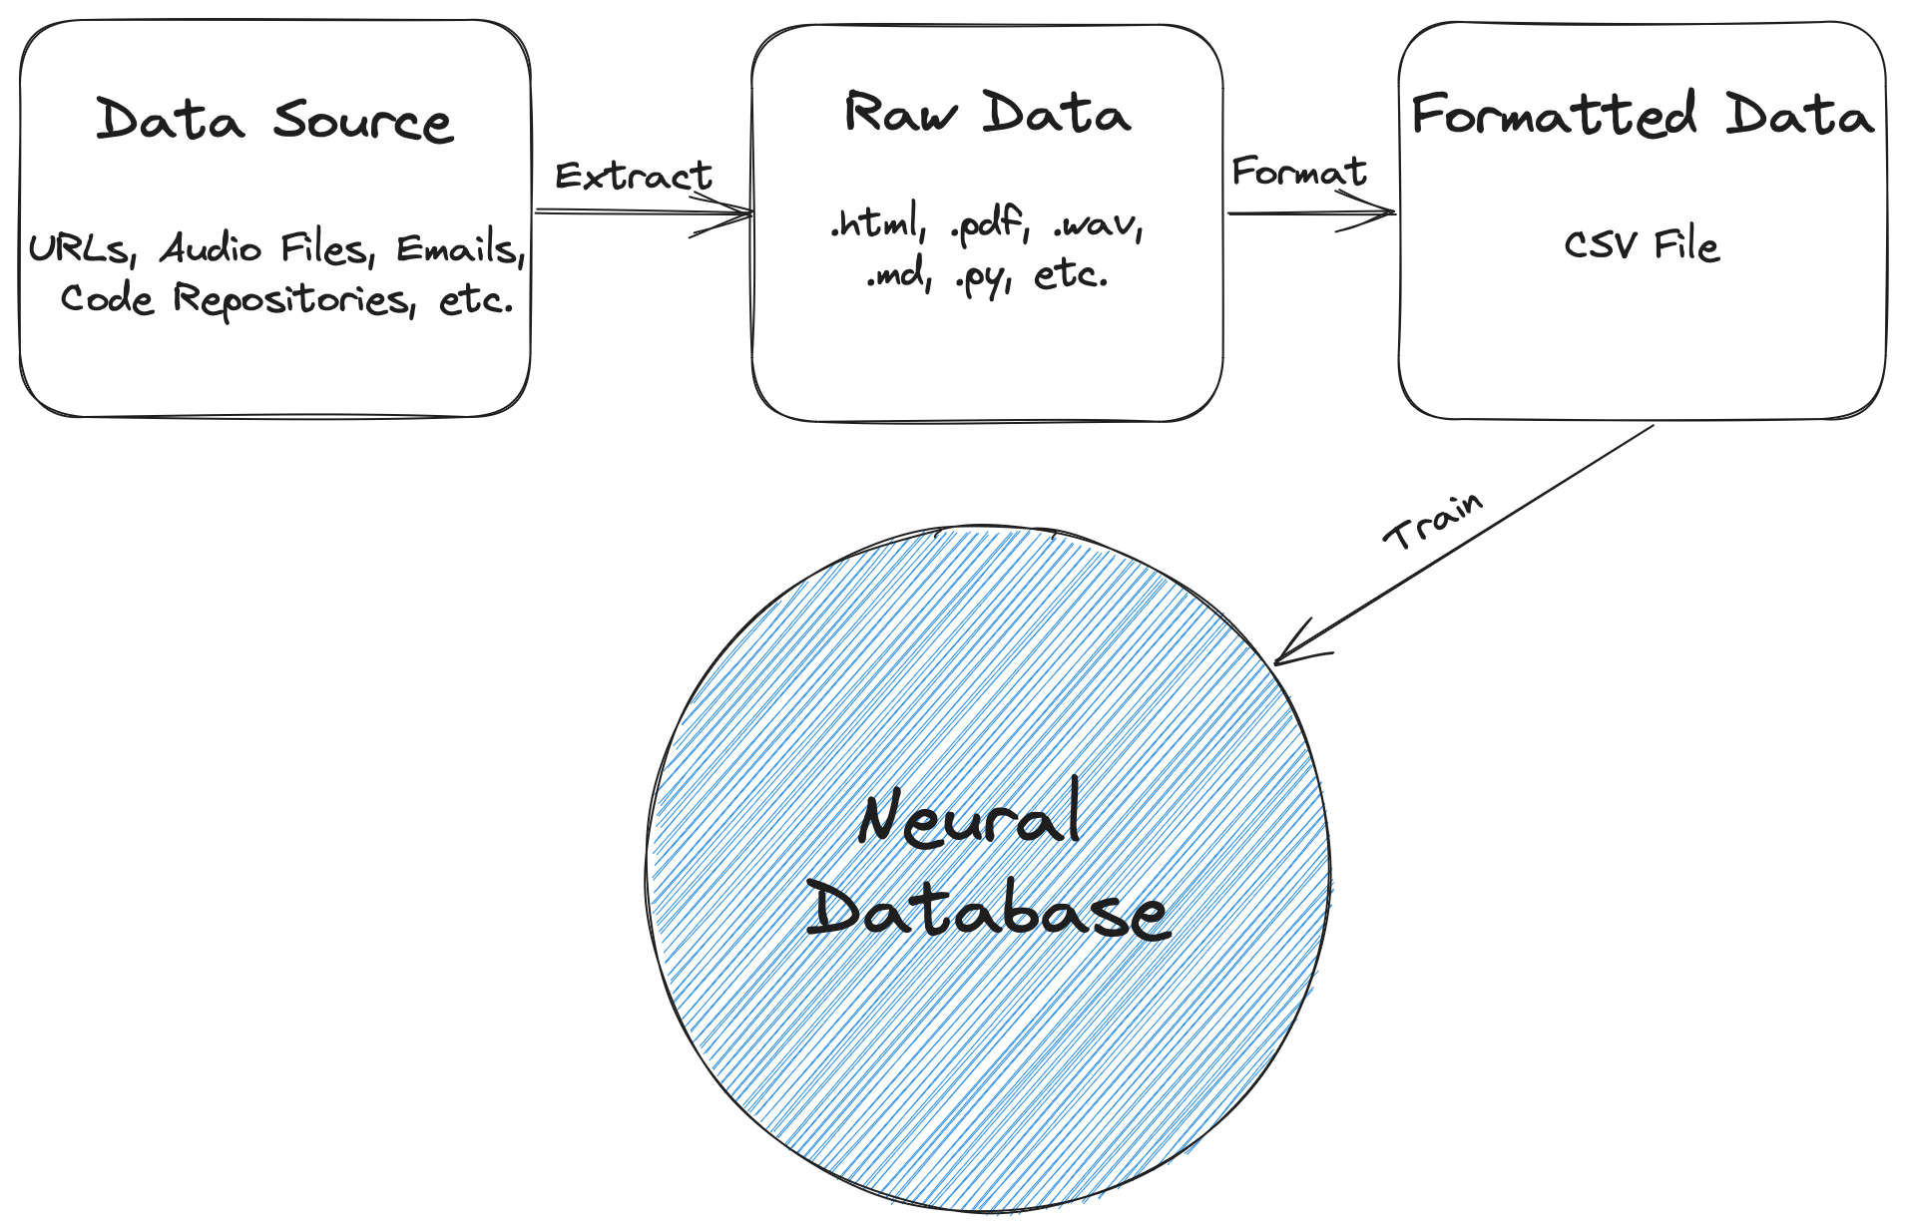
Neural Search Pipeline (Inserting)

Slide 7
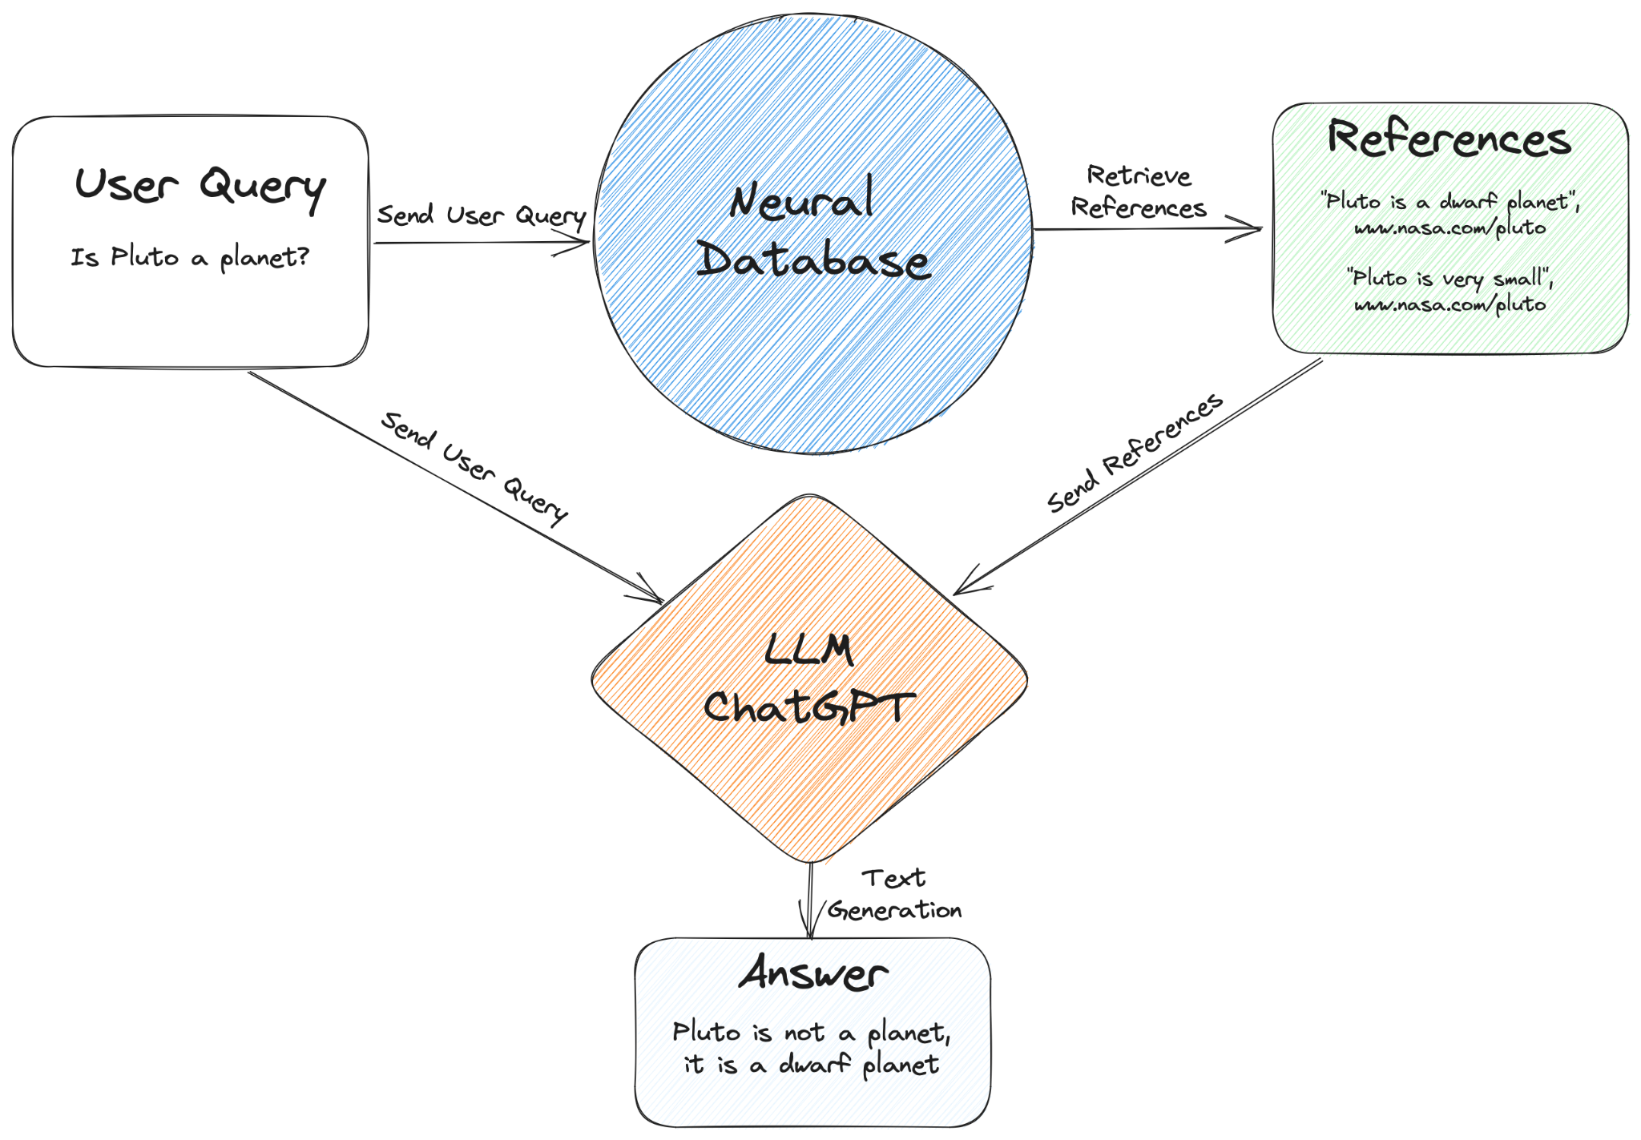
Neural Search Pipeline (Querying)

Slide 8
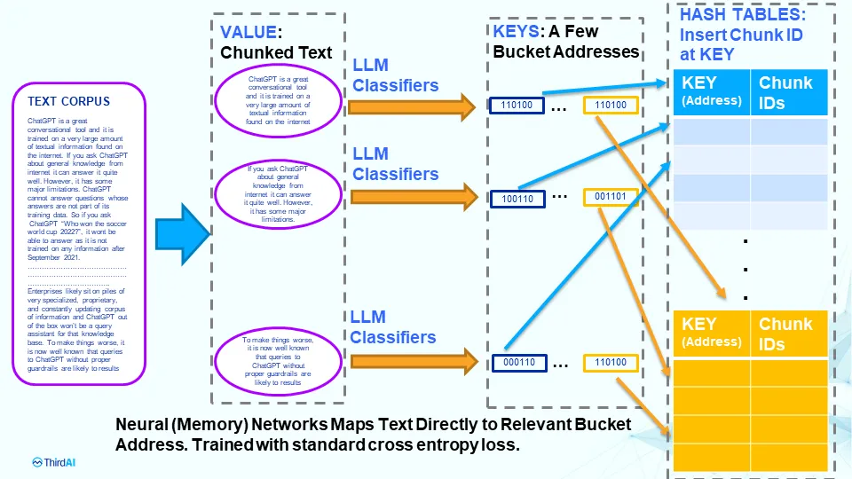
What is a Neural Database? (Inserting)

Slide 9
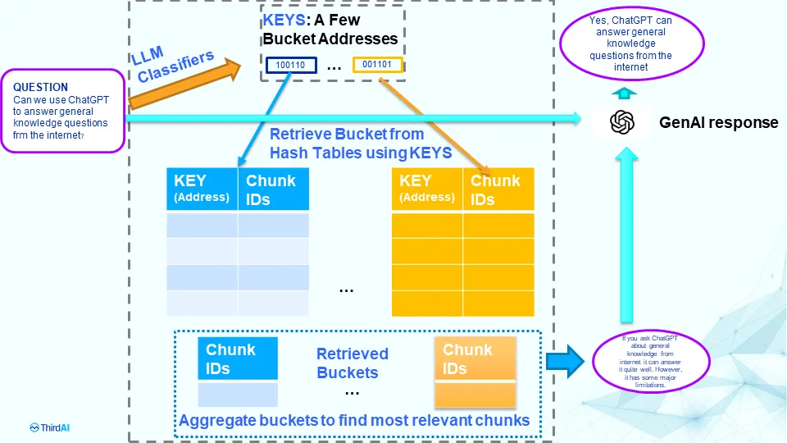
What is a Neural Database? (Querying)

Slide 10
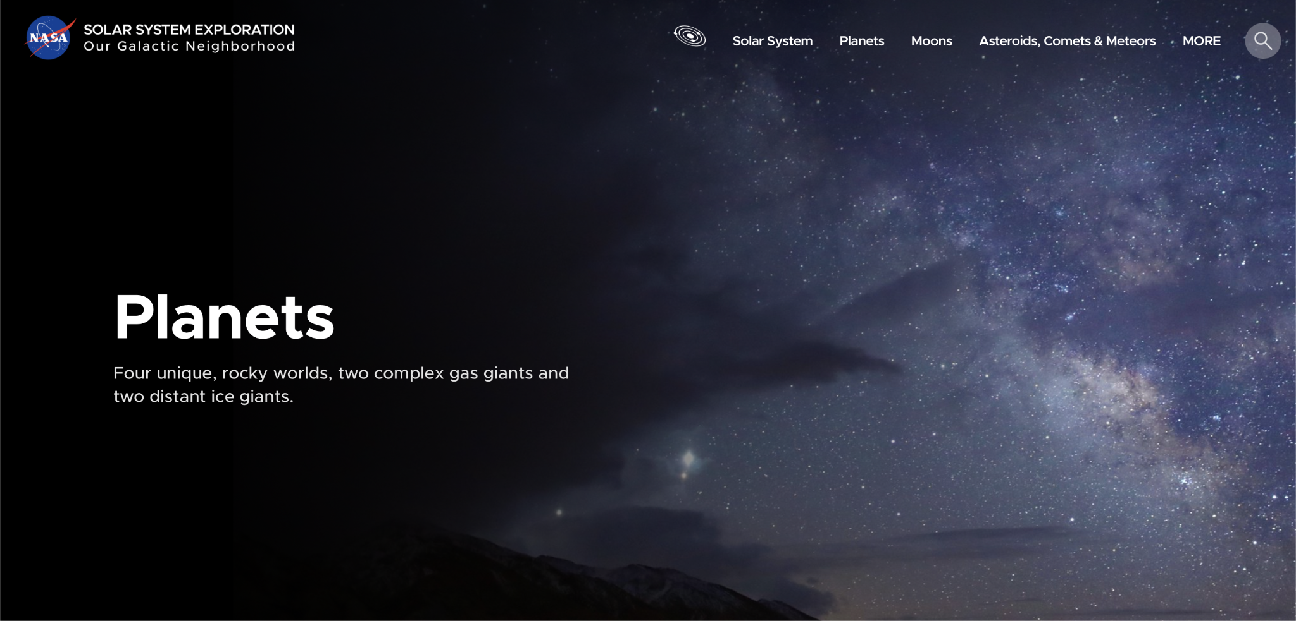
Demo Neural Search on a URL
https://solarsystem.nasa.gov/planets/

Slide 11
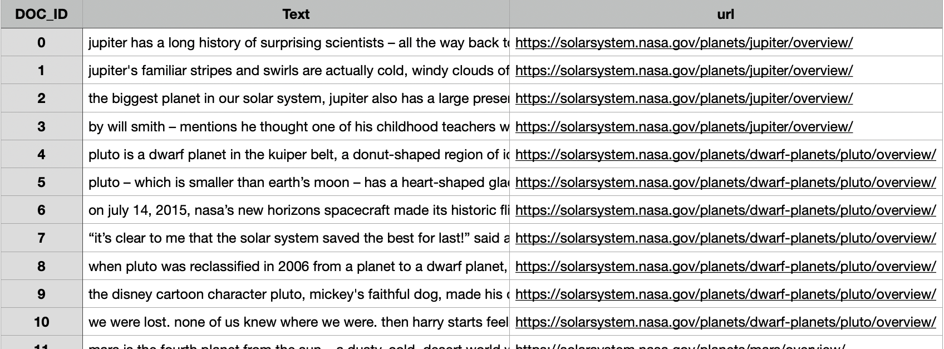
Example CSV

Slide 12
Create your own Neural Database

Slide 13
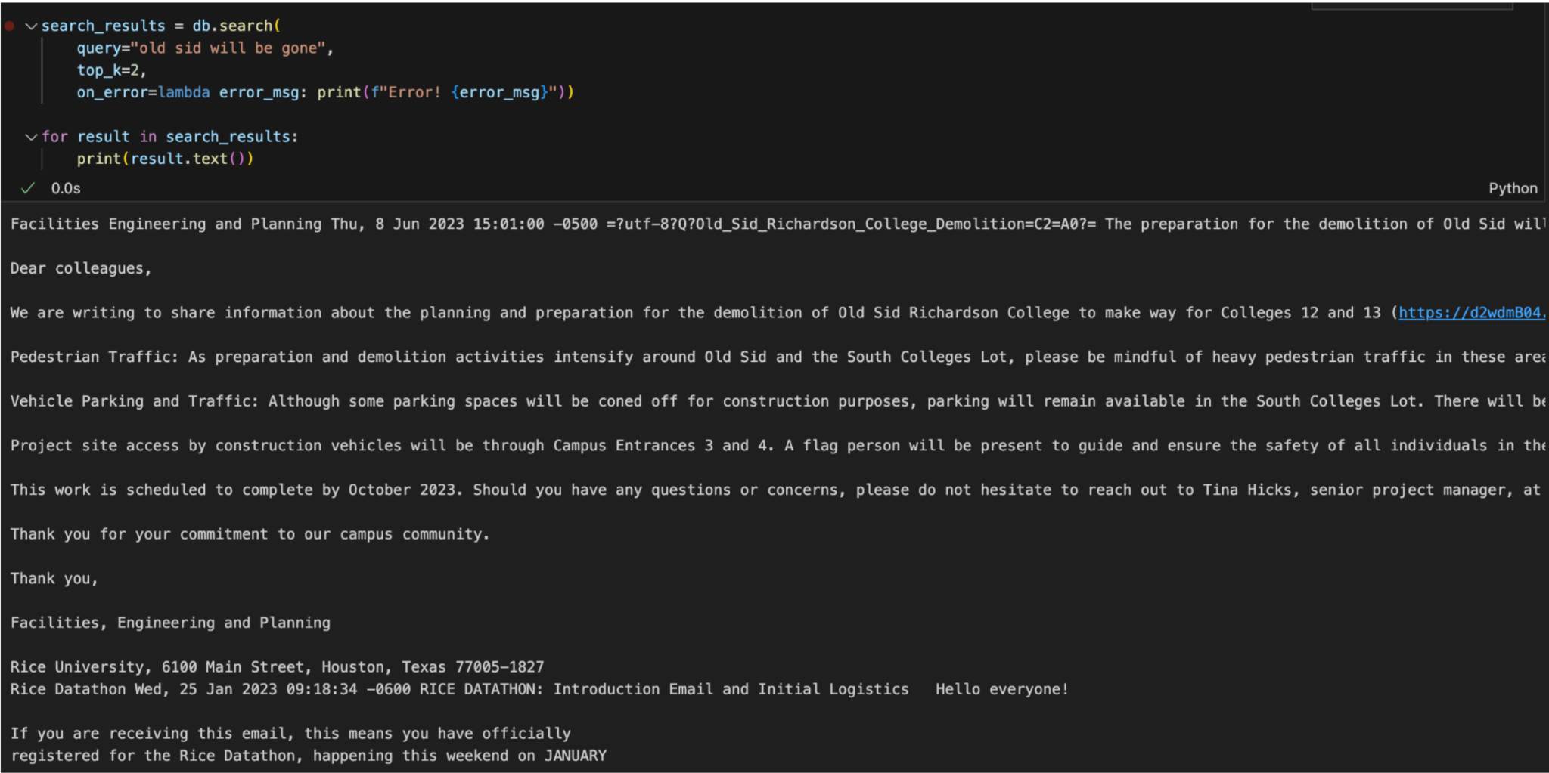
Neural DB for Gmail

Slide 14
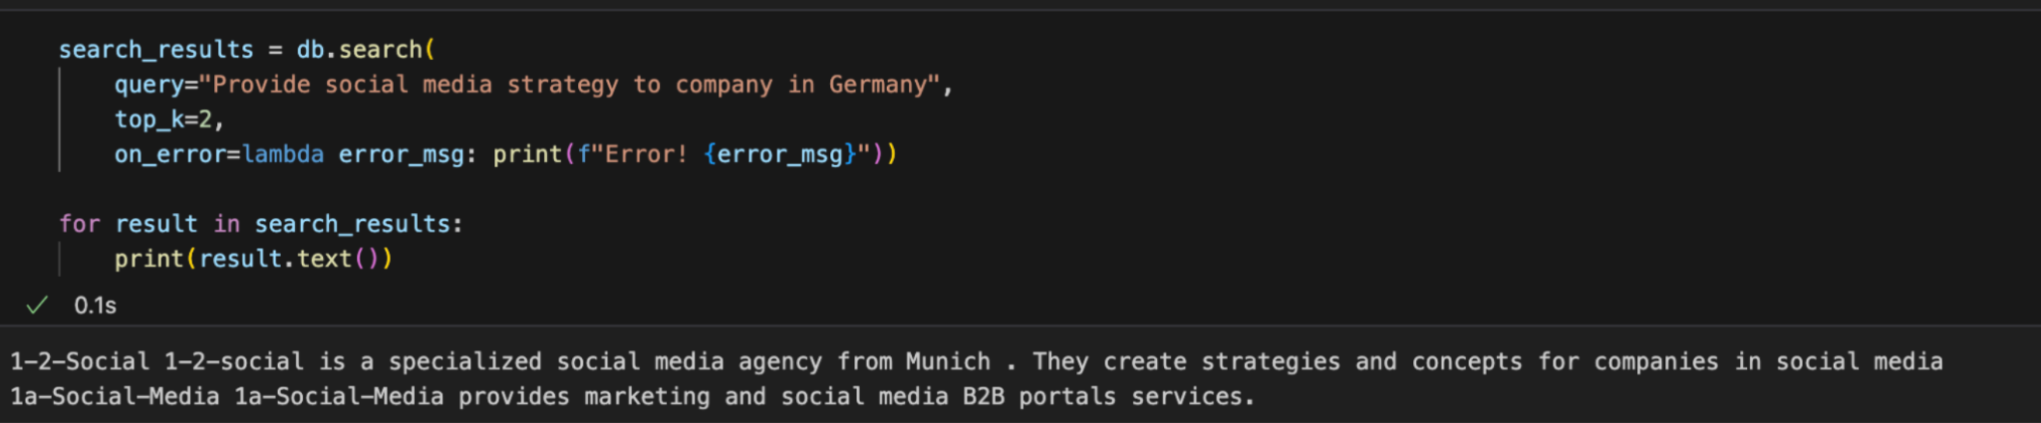
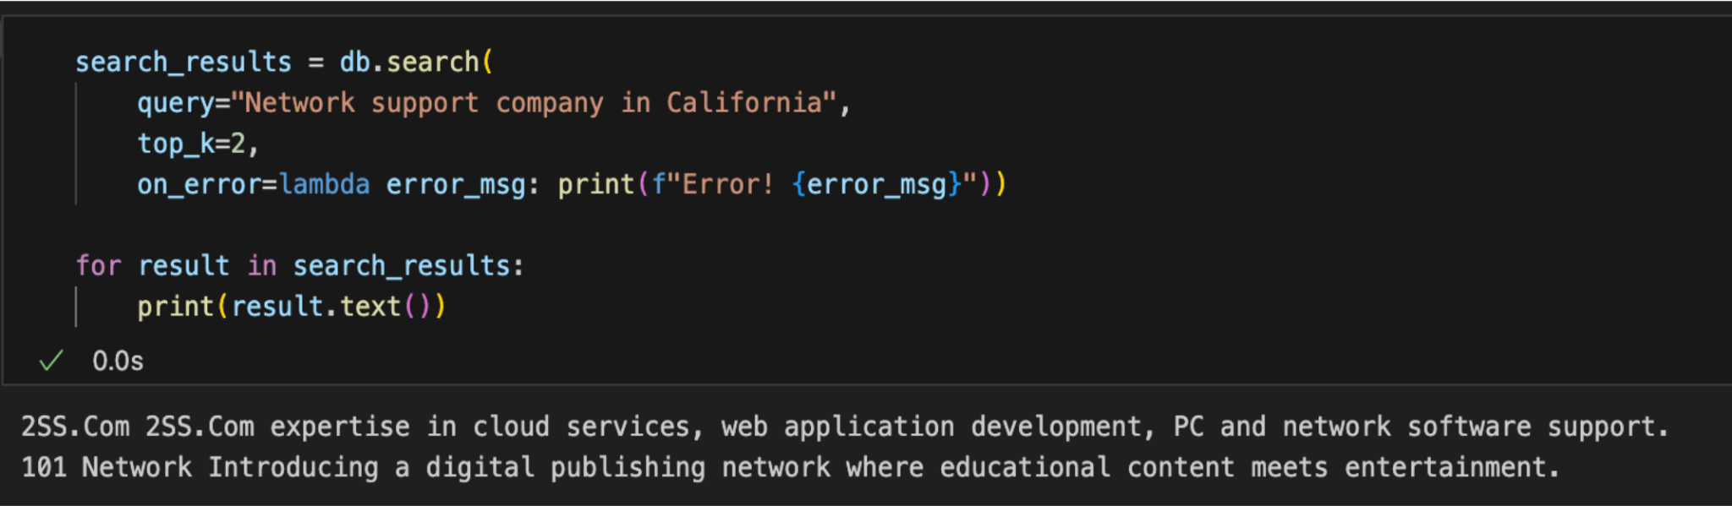
Neural DB for CrunchBase

Slide 15
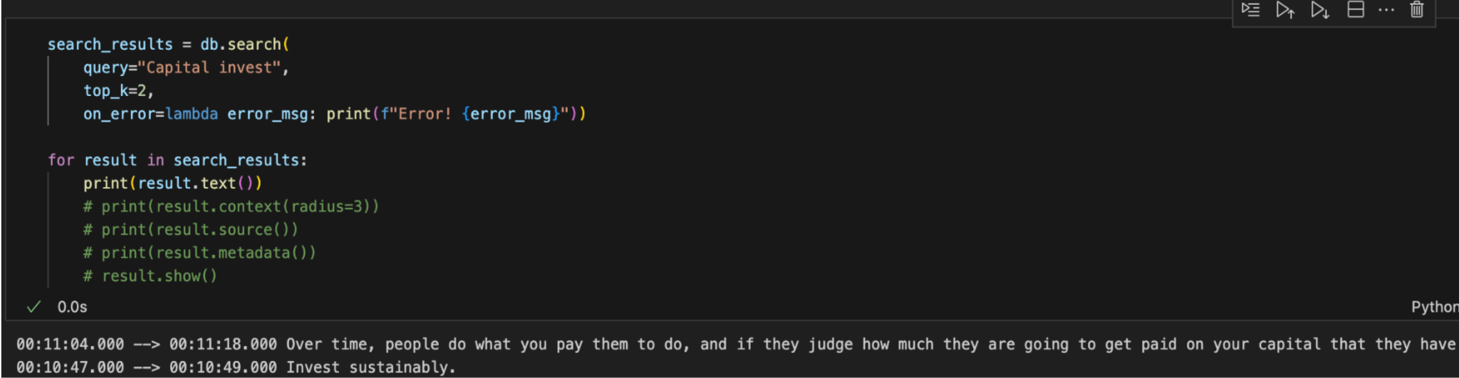
Neural DB for Audio Transcription

Slide 16
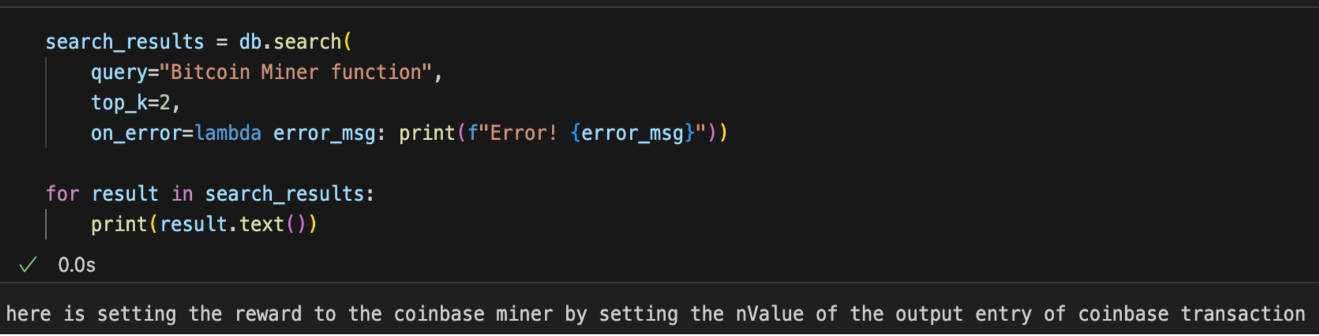
Neural DB for Code

Slide 17
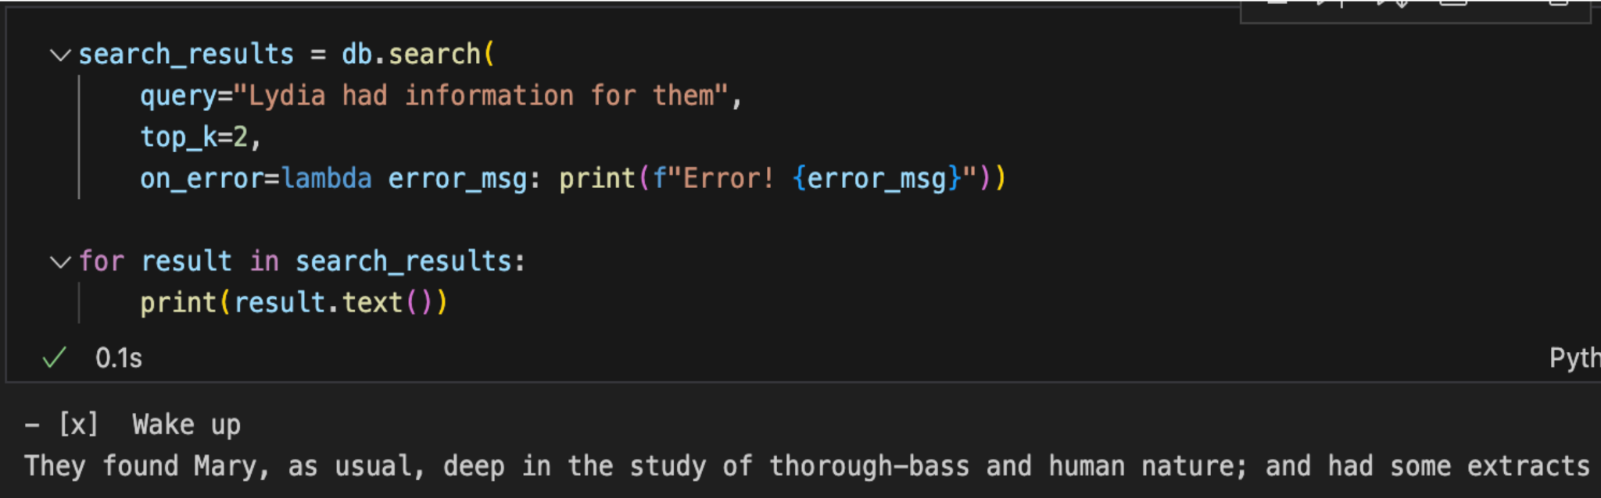
Neural DB for Notion

Slide 18
References
Gmail data extraction
Audio data extraction
Code repo data extraction
Notion notebook data extraction

Slide 19
Next Steps
How to get started
Demo notebooks (Run on Google Colab)
Download the ThirdAI package and get a trial license
Bring your data and build models 🚀🚀🚀
Bring your vision and make them better with real-time reinforcement learning.

Slide 20
Logistics and Timelines

Slide 21
Judging Criteria
Impact
Is there a clear use case?
Who will use this product?
What benefits does the product offer?
How is it compare with alternatives?
Technical Innovation
Does the product utilize innovative data processing techniques?
Does the product utilize NeuralDB capabilities in novel ways?
Were there challenges that required innovative solutions?

Slide 22
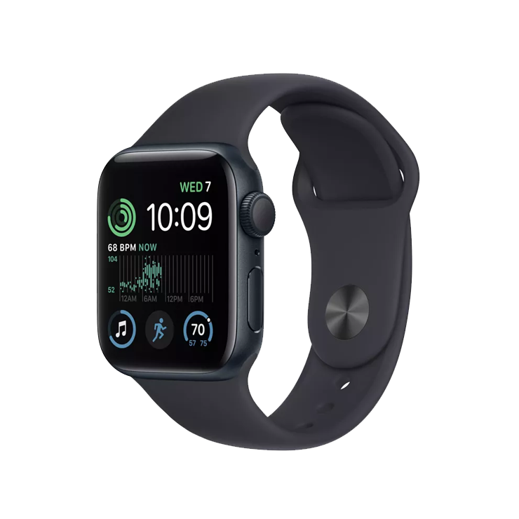
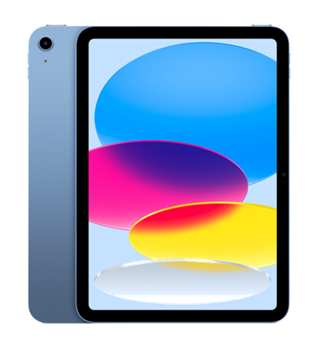

Awards
First Prize
Second Prize
*Bonus Prize
iPad
Apple watch
Launch and promotion on Product Hunt
*Bonus Prize: All user-ready projects/demos will be posted and promoted by us on Product Hunt with name credits and special mention.
Note: To ensure the proper handling and promotion of your project, please attach a completed release form along with your submission. The release form will be shared with you all on Discord. Please sign the document and submit it along with your project.

Slide 23
We look forward to your innovative project submissions.
Best of luck to all participants!
.

